Slide 1
Transportation App : GoRoute Presented By, Adith Adithya PK Mahesh Nidugula Alan K Mathew Vendant Zalke

Slide 2
Introduction
Goroute: Your Urban Mobility Companion. Discover the ease and convenience of public transportation in our city. Seamlessly plan your journeys, access real-time updates, and enjoy hassle-free travel on buses, trains, subways, and trams. Embrace the freedom of exploring the city with GoRoute.
We have local public transportation service, users can book bus, local trains , and we are also providing cab service and ride sharing facility user can choose best of there interest. IT Provide an intuitive journey planner tool that allows users to enter their starting point and destination to find the best routes, schedules, and estimated travel times. Include options for different modes of public transport (bus, train, subway, etc.), as well as any interconnections or transfers required.

Slide 3
User Research
We conducted interviews and did some surveys to understand the problem users facing with existing applications.
Insights and best practices for the German market can be gained by studying the success stories of international transportation apps like Uber, Lyft, and Grab. User feedback also identifies areas for improvement, such as vehicle availability, app usability, pricing transparency, and cleanliness. Users value the flexibility and convenience of rental transportation apps, especially for quick trips or when there are few other options for public transportation.

Slide 4
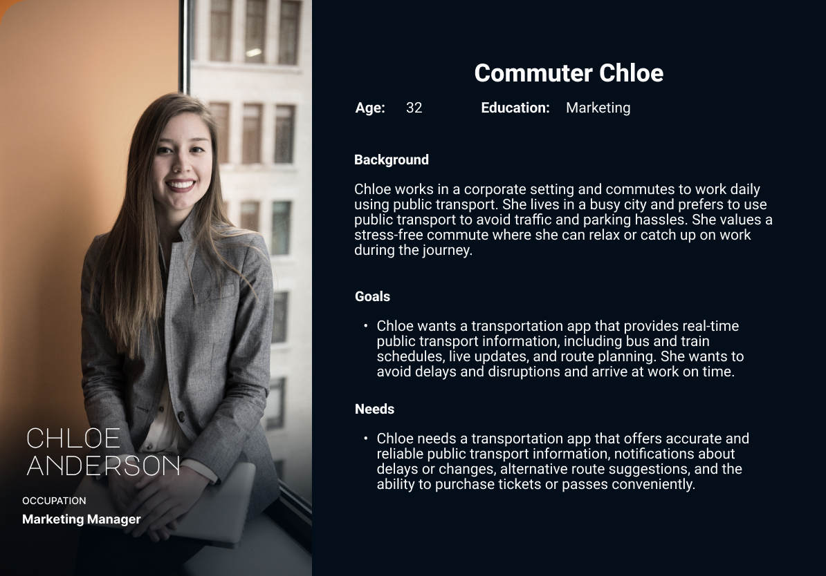
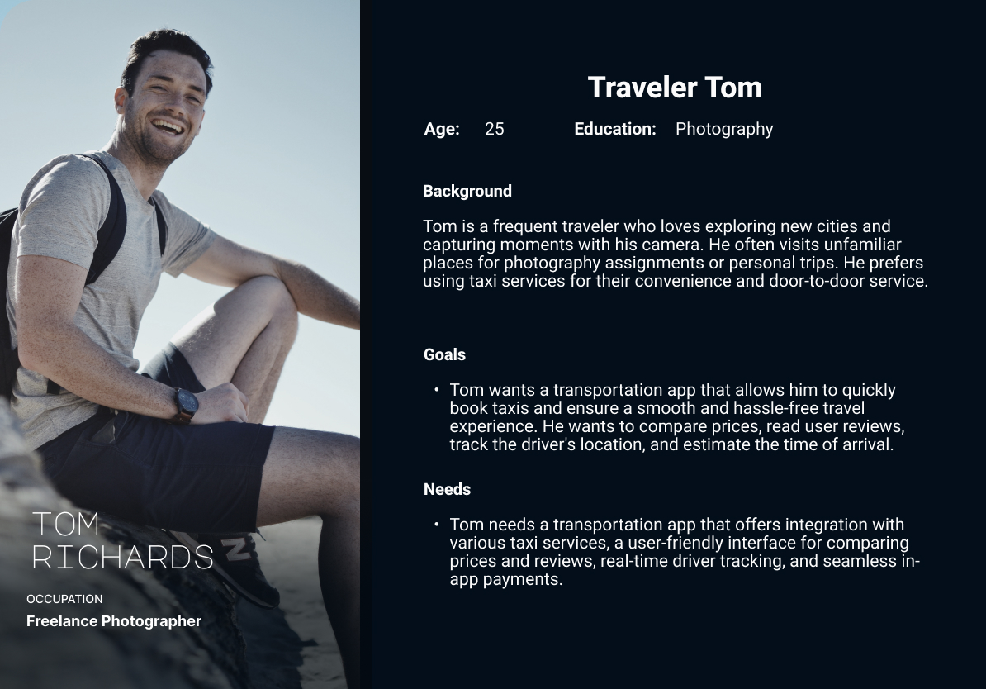
Problem Space

Slide 5
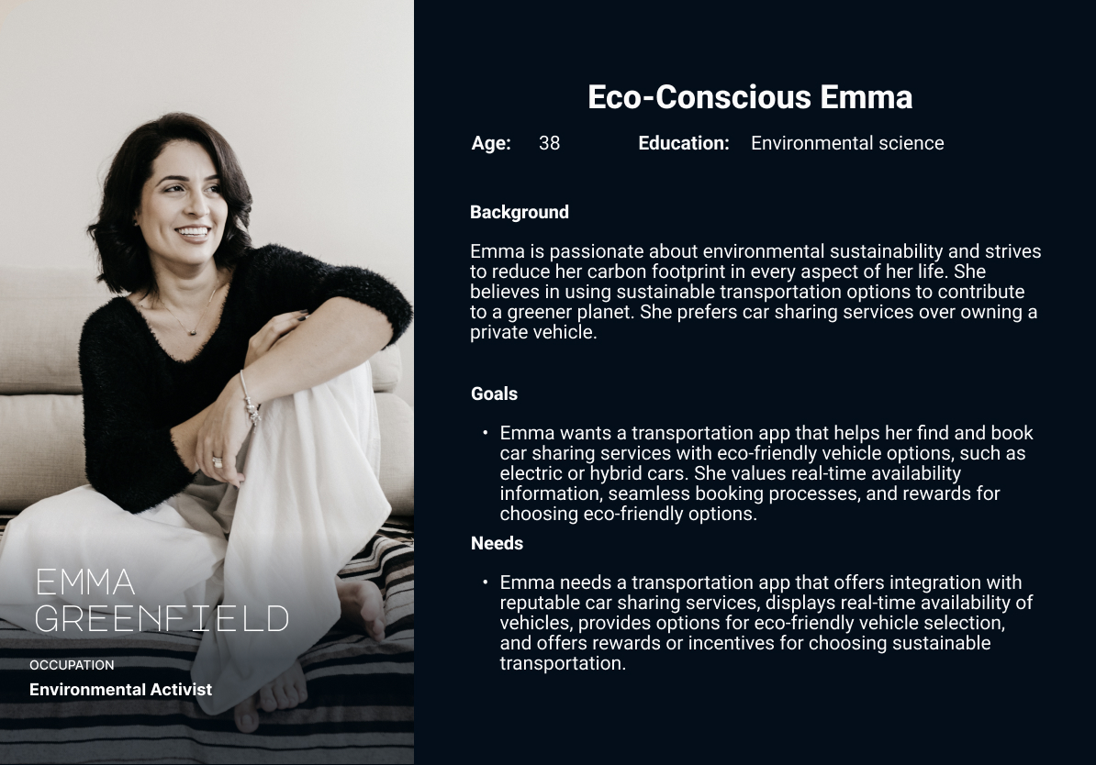
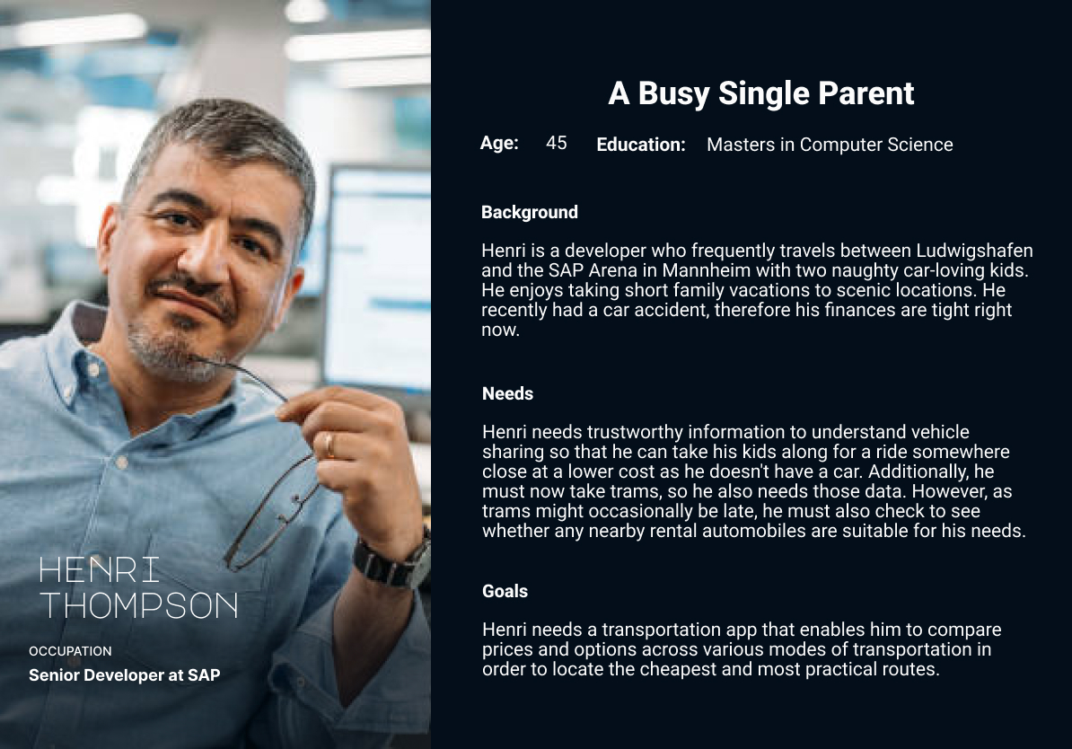
Problem Space

Slide 6
Requirements:-
Options for sharing, local and rental bikes, cars, buses, trams and trains with user-friendly applications and clear pricing.
Clear price information and intuitive applications with real-time data availability.
Respect with local laws on data protection, privacy, and safety.
Increased availability of vehicles, app dependability, and quick customer service.
Options that prioritize sustainability include electric cars and bike-sharing schemes.
Integrated platforms or applications for simple ticketing.

Slide 7
Task Analysis
Functional:-
User Registration.
Vehicle Selection and Booking.
Real-time tracking.
Secure Payment Integration.
User Feedback and Ratings.
Notifications and Alerts.
Customer support.
Booking History and Receipts.
Integration with Other Services.
Support for several Languages.
Non-Functional:-
Performance:
Reliability.
Security
Usability
Scalability
Compatibility
Accessibility.
Data Privacy.
Integration.

Slide 8
Stakeholders:-
First-tier Stakeholders:
Users, development team, product owner and transport providers.
Second-tier Stakeholders:
Research and analytics firms, local transport authorities, city administrators, environmental organizations, tourism industry, payment service providers, insurance providers, public safety organizations, communities and residents.

Slide 9
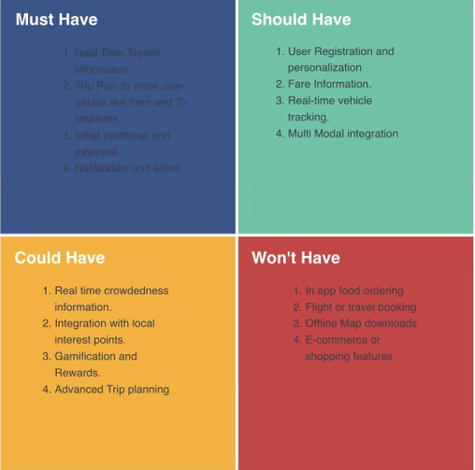
Prioritisation technique:- MOSCOW

Slide 10
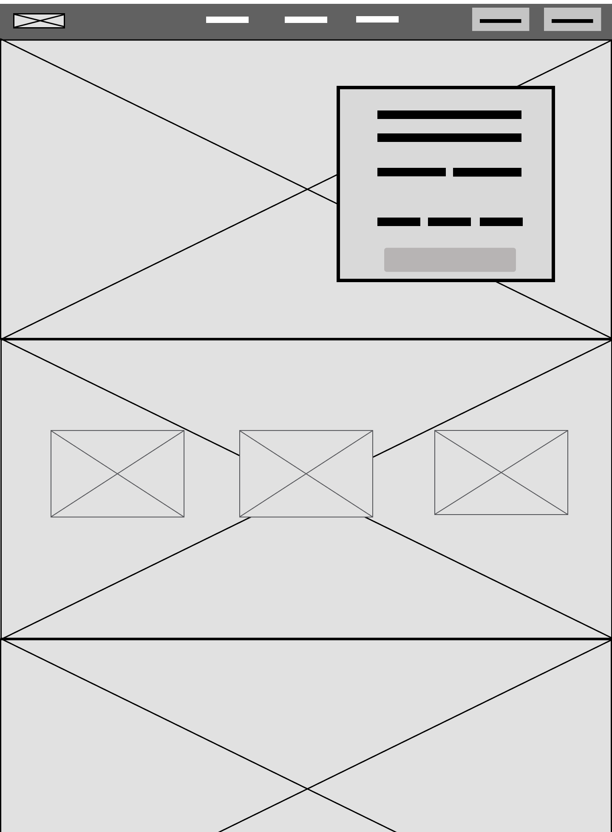
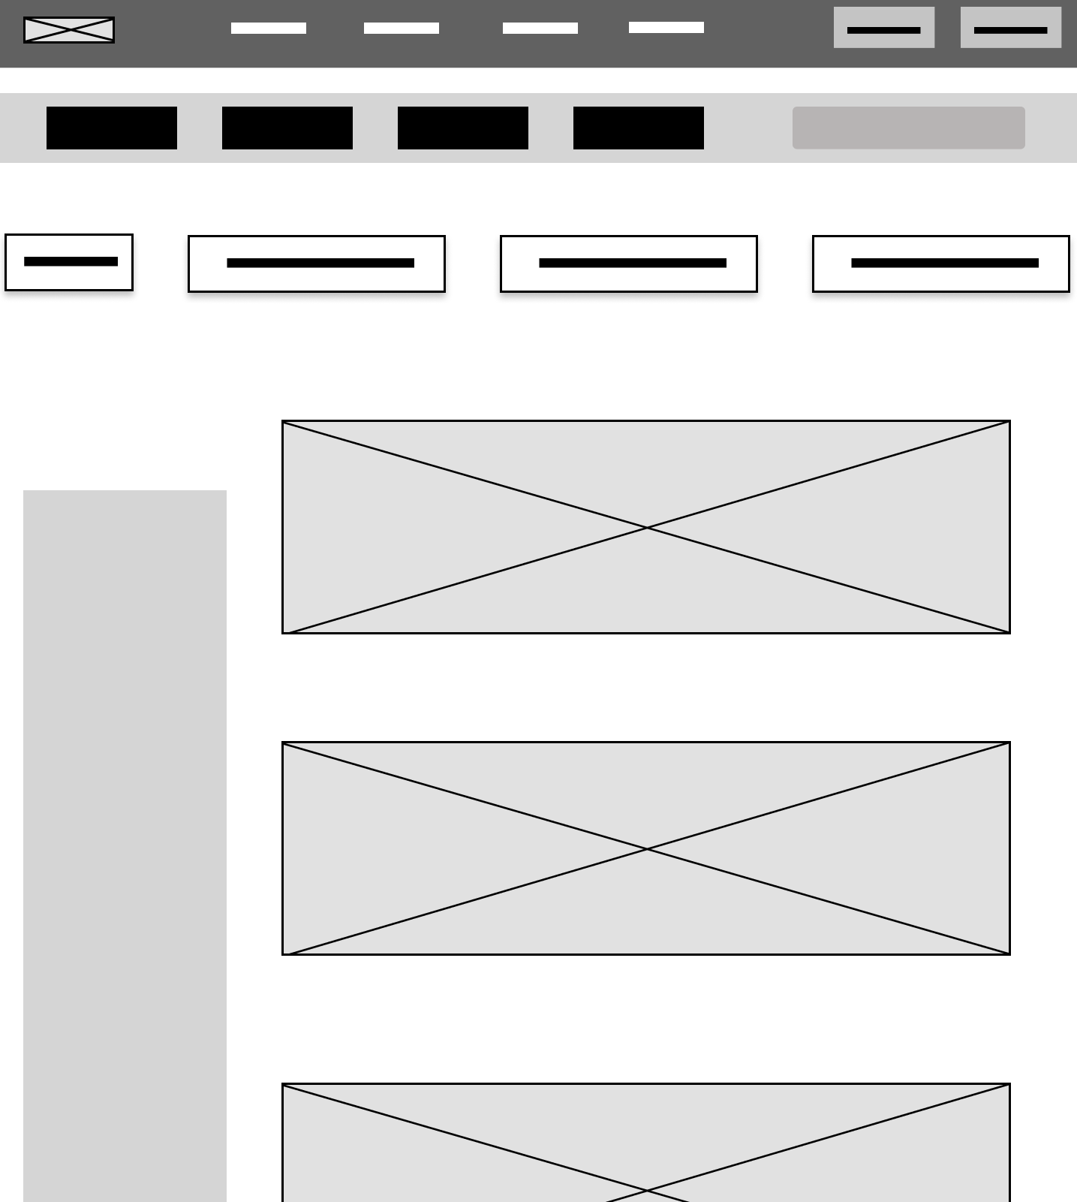
LO FI WIREFRAME
HOME
SERVICE

Slide 11
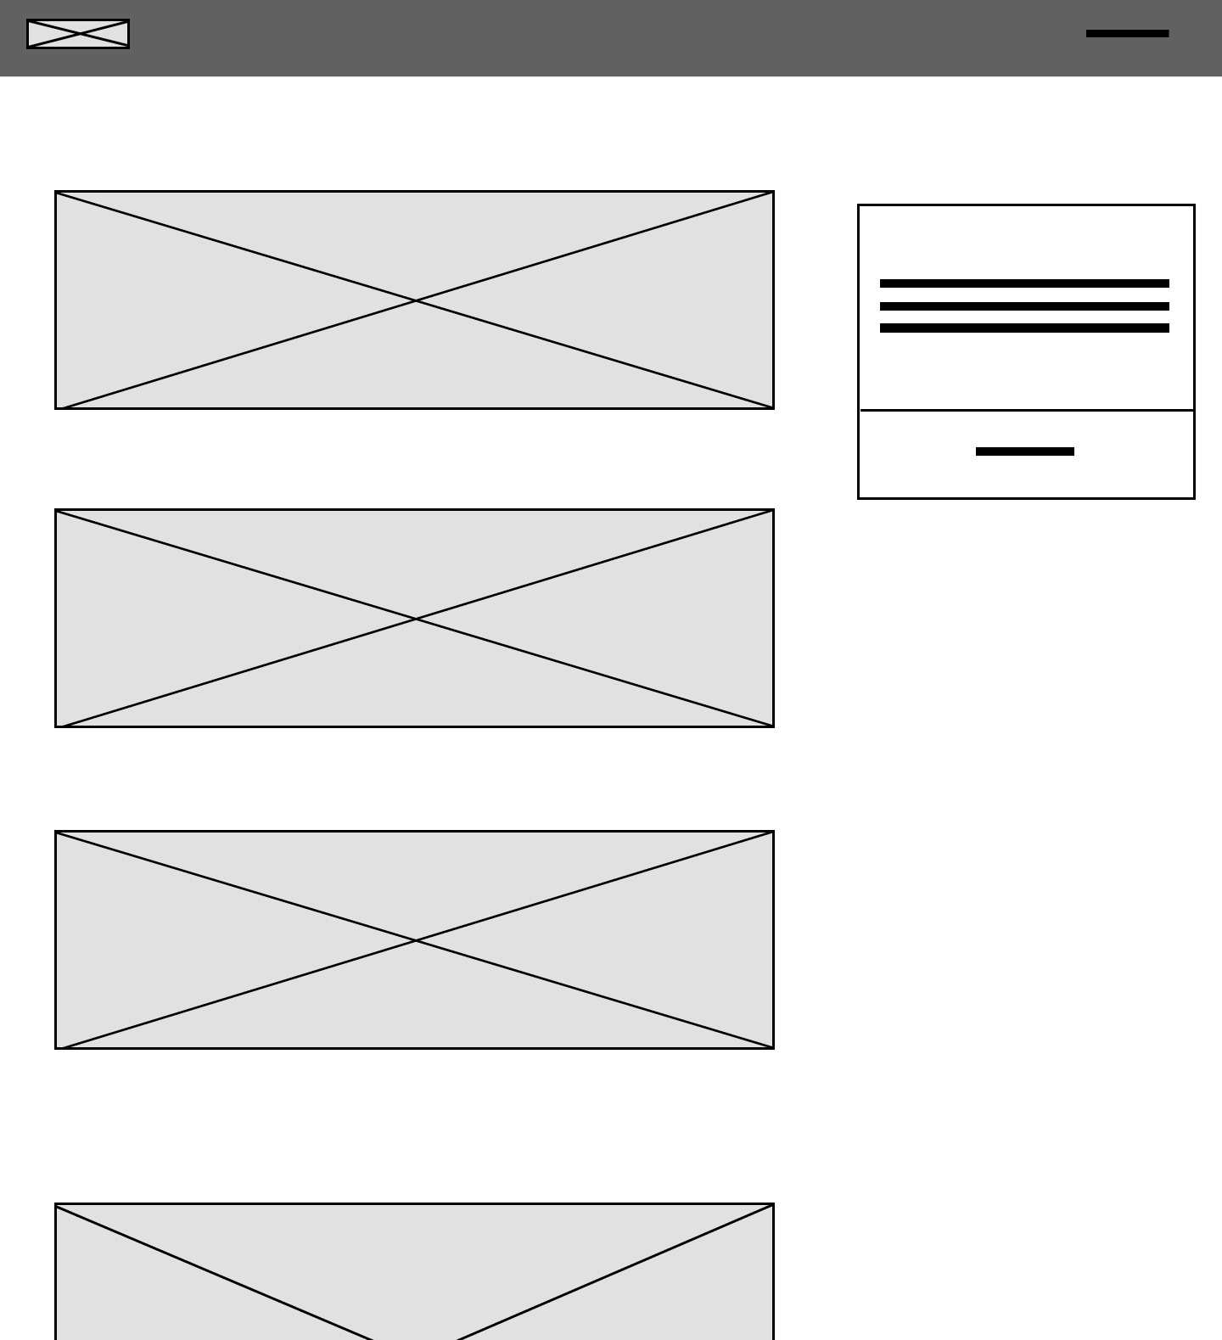
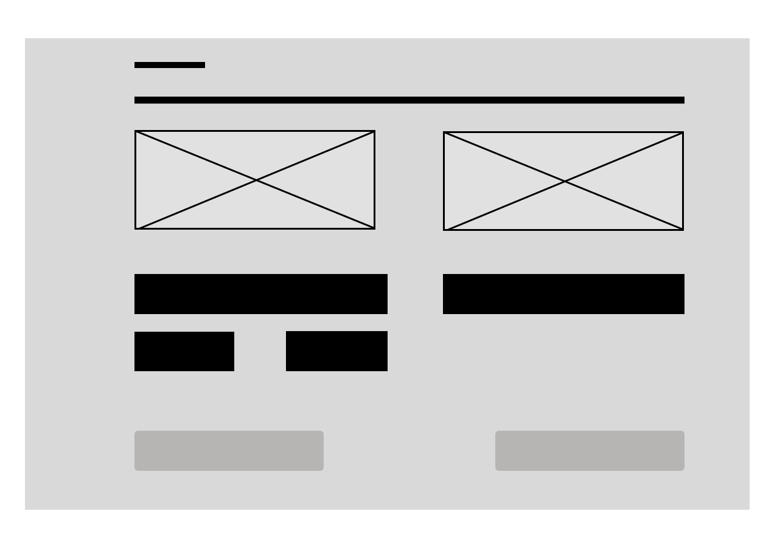
LO FI WIREFRAME
DETAILS
CHECKOUT

Slide 12
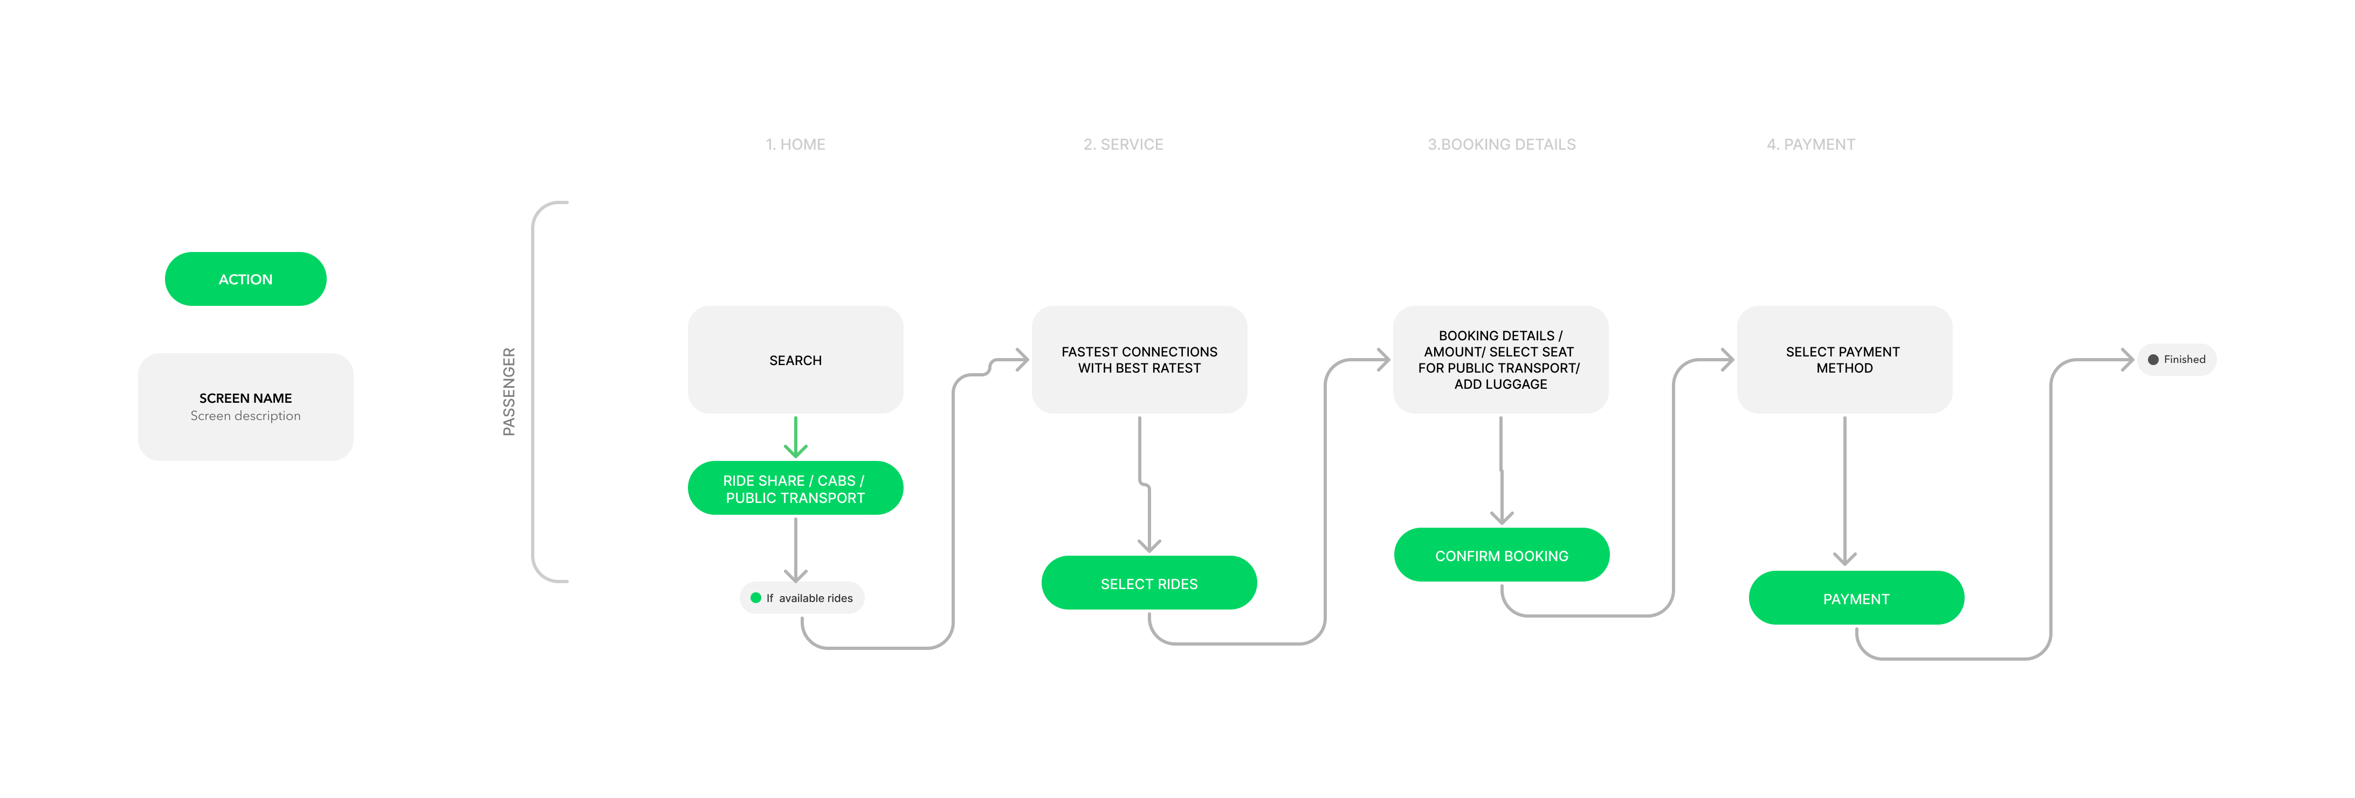
User Flow:-

Slide 13
References:-
https://www.flix.com/
https://www.uber.com/us/en/ride/
https://www.blablacar.co.uk/
https://www.freepik.com/search?format=search&query=local%20transport%20service%20website%20graphics&selection=1
https://iconscout.com/login-with-web?client_id=164901561613359&token=04d12c30-1351-11ee-8ed9-0242ac140003&utm_campaign=2.4.5&utm_medium=figma&utm_source=iconscout-plugin
https://www.w3schools.com/html/default.asp
https://legacy.reactjs.org/

Slide 14
Thankyou for your attention!

